Slide 1
Data Modelling

Slide 2
What is Data Modelling?
Process of analyzing the data objects and their relationship to the other objects.
Used to analyze the data requirements that are required for the business processes.
Data models are created for the data to be stored in a database.
Data Model's main focus is on what data is needed and how we have to organize data rather than what operations we have to perform.
Data Model is basically an architect's building plan.
Notes:
Data Modelling is the process of analyzing the data objects and their relationship to the other objects. It is used to analyze the data requirements that are required for the business processes. The data models are created for the data to be stored in a database. The Data Model's main focus is on what data is needed and how we have to organize data rather than what operations we have to perform.
Data Model is basically an architect's building plan. It is a process of documenting complex software system design as in a diagram that can be easily understood. The diagram will be created using text and symbols to represent how the data will flow. It is also known as the blueprint for constructing new software or re-engineering any application.

Slide 3
Why is Data Modeling done?
Data modeling help establish standard data definitions and internal data standards, often in connection with governance.
Plays a significant role in
Data architecture processes that document data assets
Map how data moves through IT systems
Create a conceptual data management framework
Notes:
Data modeling help establish standard data definitions and internal data standards, often in connection with governance.
Data models are a vital data architecture component, along with flow diagrams, architectural blueprints, a unified vocabulary, and other artifacts.
Data Modeling plays a significant role in
Data architecture processes that document data assets
Map how data moves through IT systems
Create a conceptual data management framework
Before, models were built by data modelers and architects, and other data stewards with input from business analysts, executives, and users. But data modeling is also essential for data scientists and analysts involved in developing BI applications and complex data science and analytics.

Slide 4
What are the best Data Modelling tools?
Elixir Data
ER/Studio
DbSchema
HeidiSQL
Toad Data Modeler
ERBuilder
Notes:
https://dbdiagram.io/
https://www.erwin.com/products/erwin-data-modeler/
drawio.com

Slide 5
What are Data Modeling tools used for?
Uses of tools in any sector or industry
Create a robust design with a data model that can show an organization's entire data on the same platform.
All the data objects required by the database are represented or not.
The database at the logical, physical, and conceptual levels can be designed with the help data model.
The relation tables, foreign keys, and primary keys can be defined with the data model's help.
The Tools help in the improvement of data quality.
Gives the clear picture of business requirements.
Redundant data and missing data can be identified with the help of data models.
In data models, all the important data is accurately represented. The chances of incorrect results and faulty reports decreased as the data model reduces data omission.
The data models create a visual representation of the data.
Better consistency can be qualified with the help of a data model across all the projects.
The model is quite a time consuming, but it makes the maintenance cheaper and faster.
Notes:
Data Modelling is a process to formulate data in an information system in a structured format. Listed below are certain practical uses of the related tools in any sector or industry.
It helps create a robust design with a data model that can show an organization's entire data on the same platform.
The data model makes sure that all the data objects required by the database are represented or not.
The database at the logical, physical, and conceptual levels can be designed with the help data model.
The relation tables, foreign keys, and primary keys can be defined with the data model's help.
The Tools help in the improvement of data quality.
Data Model gives the clear picture of business requirements.
Redundant data and missing data can be identified with the help of data models.
In data models, all the important data is accurately represented. The chances of incorrect results and faulty reports decreased as the data model reduces data omission.
The data models create a visual representation of the data. With the help of it, the data analysis gets improved. We get the data picture, which can then be used by developers to create a physical database.
Better consistency can be qualified with the help of a data model across all the projects.
The model is quite a time consuming, but it makes the maintenance cheaper and faster.

Slide 6
What are the 3 types of Data Models?
Conceptual Model
Logical Model
Physical Data Model
Notes:
Data Modelling helps to create a conceptual model and create the relationship between the items. The basic techniques involve dealing with three perspectives of a data model.

Slide 7
Conceptual Model
First and the most abstract data model in the data modeling process.
It is a high-level diagram that we use to define, describe, organize, and present data elements and their relationships with relatively few details.
Conceptual data models contain only:
The real-world entities that are our main data elements.
Their relationships.
This model does not have technical details, such as attributes, data types, etc.
Notes:
The conceptual data model is the very first and the most abstract data model in the data modeling process. It is a high-level diagram that we use to define, describe, organize, and present data elements and their relationships with relatively few details. Conceptual data models contain only:
The real-world entities that are our main data elements.
Their relationships.
This model does not have technical details, such as attributes, data types, etc.

Slide 8
Example of Conceptual Data Model
Database Model for Purchasing System
Entities:
Purchasing Order
Purchasing Order Item
Stock Item
Supplier
Good Received Note
Notes:
What will I store in my purchasing system? The entities below are the real-world objects that I’ll need to track in my database. I think you’ll quickly understand what each entity represents:

Slide 9
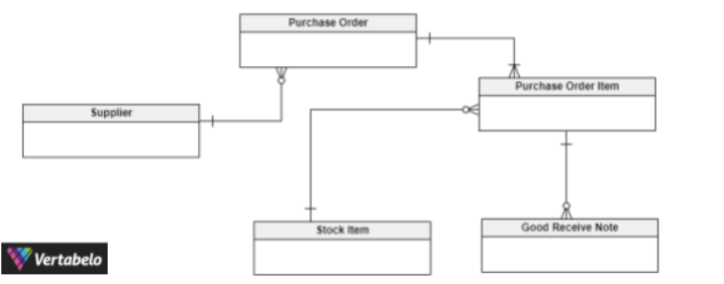
Example of Conceptual Data Model
Database Model for Purchasing System
Notes:
And these are the relationships between these entities:
A Purchasing Order has many Purchasing Order Items A Purchasing Order Item can belong to only one Purchasing Order. That means the Purchasing Order and Purchasing Order Item entities have a one-to-many relationship.
Many Purchasing Orders can be sent to one Supplier. Thus, there will be a one-to-many relationship between the Supplier and Purchasing Order And having a Supplier should be mandatory for all Purchasing Orders.
One Purchasing Order Item should have one Stock Item, but one Stock Item may have zero or many Purchasing Order Items. That means that between Stock Item and Purchasing Order Item there is a one-mandatory-to-many-optional relationship.
When ordered items are received for a Purchasing Order, we create a Good Received Note (GRN) for each Purchasing Order Item. Assuming ordered items for a Purchasing Order can be delivered by the supplier either at once or as split deliveries, a Purchasing Order Item can have zero or many Good Received Notes. However, one Good Received Note can belong to only one mandatory Purchasing Order Item. Thus, Purchasing Order Item and Good Received Note have a one-mandatory-to-many-optional relationship.

Slide 10
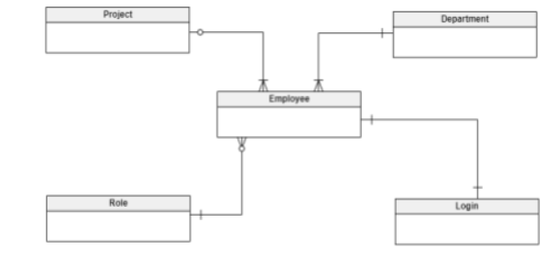
Conceptual Data Model Examples, with ER Diagrams
Notes:
This is an ER diagram of a conceptual data model for a simple employee management system. In this company, there are many departments and many employees in each department. Employees are assigned to different projects and can only work on one project at a time; some employees may not have been assigned to any projects. Each employee has a role (i.e. a job role); many employees can have the same role. Also, there may be vacant roles. Each employee has a login to access the company’s common network, but there are different user privileges.
To support these business requirements, I have designed the conceptual data model shown above. It has five entities (Employee, Department, Project, Role, and Login) that reflect the real-world entity information in the physical database. There are four relationships that support the described business scenario:
Department_Employee: A one-mandatory-to-many-mandatory relationship.
Project_Employee: A one-optional-to-many-mandatory relationship.
Role_Employee: A one-mandatory-to-many-optional relationship.
Employee_Login: A one-mandatory-to-one-mandatory relationship.

Slide 11
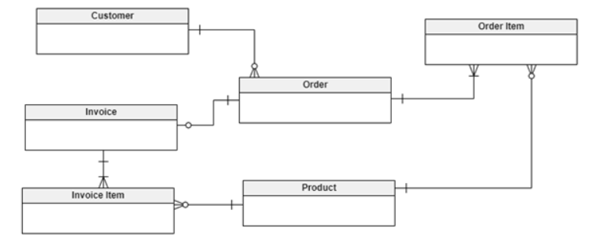
Simple Order Management System
Notes:
This is a conceptual data model for a simple order management system for a wholesale store. Customers send orders to the store, although some customers may not have sent any orders yet. An order has many order items, and each order item is for one product. There may be products that do not have an order. After gathering the products into an order, an invoice will be prepared for that order. An invoice has many invoice items, with one product in each invoice item.
This ER diagram shows how we’ll support the above business requirements. The model has six entities (Customer, Order, Order Item, Product, Invoice, and Invoice Item) that represent the real-world information in our physical database.
There are six relationships in this data model:
Customer_Order: A one-mandatory-to-many-optional relationship.
Order_Order Item: A one-mandatory-to-many-mandatory relationship.
Product_Order Item: A one-mandatory-to-many-optional relationship.
Order_Invoice: A one-mandatory-to-one-optional relationship.
Invoice_Invoice Item: A one-mandatory-to-many-mandatory relationship.
Product_Invoice Item: A one-mandatory-to-many-optional relationship.

Slide 12
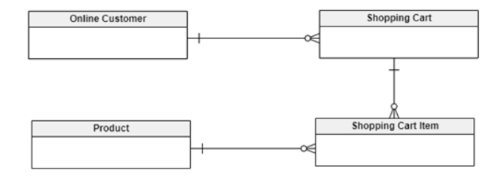
Online Shopping App
Notes:
This is an ER diagram for an online shopping app data model. Customers can sign up for the app, log into the system using their credentials, and shop online. When a customer starts looking for items, the app opens a shopping cart and adds a shopping cart item for each product that the customer adds to their cart. When the customer checks out, the app reads each shopping cart item’s details, updates the shopping cart header, and generates the final bill using the same information. The app also stores each customer’s shopping history.
This ER diagram contains four entities that reflect real-world object information in our physical database – Online Customer, Shopping Cart, Shopping Cart Item, and Product.
There are three relationships required to support the above business scenario:
Online Customer_Shopping Cart: A one-mandatory-to-many-optional relationship.
Shopping Cart_Shopping Cart Item: A one-mandatory-to-many-optional relationship.
Product_Shopping Cart Item: A one-mandatory-to-many-optional relationship.

Slide 13
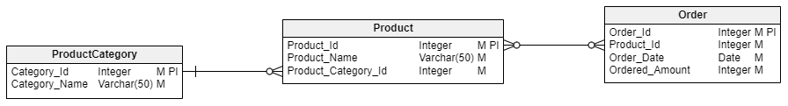
Logical Model
A logical model visualizes database tables, columns, and the connections between them. In a logical model, the tables are called entities and the columns are called attributes.

Slide 14
When should I consider a logical data model?
Once conceptual data model has been built we can consider Logical Data Modelling
More structured stage of data modeling is most relevant during application design, when it can serve as a communication mechanism in the more technical environments where database analysts and designers work.
It helps us understand the details of the data to a greater degree than conceptual data models – but similarly stops short of providing perspective on how it should be implemented.
As with conceptual data modeling, this means teams aren’t bound to technological considerations. This is important as the nature of technology in organizations is often dynamic.
Notes:
We’ve got three entities here: Order, Product, and ProductCategory. Each of these entities has its own attributes. For example, the attributes of the Order entity are Order_Id, Product_Id, Order_Date, and Ordered_Amount.
The attributes can be divided into two groups: key and non-key; for instance, the key attribute of the Order entity is Order_Id. Also, each attribute is assigned a data type, as we’ll discuss later.
The above logical model also contains information about the relationships between the entities. There is a one-to-many relationship between the ProductCategory and Product entities. So one category can be assigned to many products, but one product can have only one category assigned to it. Also, there is a many-to-many relationship between the Product and Order entities. As you’ve probably already figured out, one product can be assigned to many orders and one order can have many products assigned to it.
So the logical model is a diagram presenting entities (tables) with their attributes (columns) and the relationships between them. Thus, a question arises: How is a logical model different from a physical model?

Slide 15
Why should I use a logical data model?
An easy way to comprehend when and why a logical data model would be relevant is to consider the model’s intended audience – database analysts, system analysts and designers.
Logical data modeling’s audience and place in the application-design process means excluding context and detail in favor of accessibility is less relevant.
The extra layer of detail (when compared to conceptual data modeling) is the context architects require to ensure new applications are compatible with the data they will encompass.
Essentially, a logical data model provides the foundations necessary for productive database design.
Notes:
An easy way to comprehend when and why a logical data model would be relevant is to consider the model’s intended audience – database analysts, system analysts and designers. Logical data modeling’s audience and place in the application-design process means excluding context and detail in favor of accessibility is less relevant. The extra layer of detail (when compared to conceptual data modeling) is the context architects require to ensure new applications are compatible with the data they will encompass. Essentially, a logical data model provides the foundations necessary for productive database design.
Without a logical data model, designers can only really figure out a new application’s requirements as they go. This will often mean working with unorganized data elements that make overlooking such requirements more likely. So, skipping the logical data modeling stage in favor of building a physical data model can lead to poor database design and applications that do not function as intended. Addressing such missteps requires a reactive approach that can slow down time to market and increase the total costs associated with the development process.
Additionally, the technology-agnostic nature of a logical data model helps organizations establish opportunities for process improvements. This means new applications can be built to be as effective as possible, rather than as effective as current technological constraints allow.

Slide 16
Benefits of logical data modeling
Help organizations identify areas for business process improvement
Reduce costs and increase efficiency
Design well-informed applications
Provide a basis for future models
Notes:
Help organizations identify areas for business process improvement
By building a model untethered to current technological constraints, organizations can identify what is required to realize the ideal version of the model.
Design well-informed applications
By accounting for the attributes of data elements, we can reduce the amount of semantic oversight that could lead to problems down the road. Data elements are better defined, and the relationships between them are more complete.
Reduce costs and increase efficiency
By mitigating the potential for oversights, organizations reduce the risk of botched implementations and the need for revisions post-launch. Additionally, data re-use and sharing is encouraged and data redundancy and inconsistencies can be avoided.
Provide a basis for future models
Just as a conceptual data model provides the basis for a logical data model, a logical data model provides the detailed design to be targeted and tuned to a specific technology in the physical data modeling stage.

Slide 17
Physical Data Model
The implementation is described using a specific database system.
It defines all the components and services that are required to build a database.
It is created by using the database language and queries.
The physical data model represents each table, column, constraints like primary key, foreign key, NOT NULL, etc.
The main work of the physical data model is to create a database.
This model is created by the Database Administrator (DBA) and developers.
This type of Data Modelling gives us the abstraction of the databases and helps to create the schema.
This model describes the particular implementation of the data model.
The physical data model helps us to have database column keys, constraints, and RDBMS features.

Slide 18
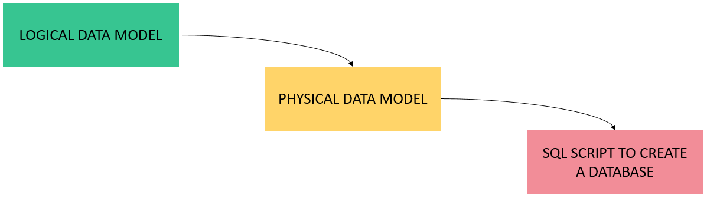
Logical Model vs. Physical Model
Both logical and physical models are diagrams that help us visualize database structure.
The main difference between them is that a logical model is not database-specific.
On the other hand, a physical model is designed for a specific database engine (e.g. MySQL, Oracle, PostgreSQL, etc.).
Notes:
A logical model provides business information and rules about the database. Here, the entity and attribute names don’t need to resemble table and column names. The physical model must have sufficient information to build the database, including table names, column names, database-specific data types, and other database objects. The Vertabelo data modeler can even generate SQL scripts that create a database from your physical model.
As shown in the above image, Tools lets you convert a logical model into a physical model and then generate an SQL database creation script from the physical model.
When designing a database, you’d first use a logical model to define the database structure. After deciding on your database engine, you’d convert your logical model to a physical one.

Slide 19
What are the Data Modelling techniques?
Different types of techniques used to organize the data:
Hierarchical Technique
Object-oriented Model
Network Model
Entity-relationship Model
Relational Technique
Notes:
Hierarchical Technique
The hierarchical model is a tree-like structure. There is one root node, or we can say one parent node and the other child nodes are sorted in a particular order. But, the hierarchical model is very rarely used now. This model can be used for real-world model relationships.
Object-oriented Model
The object-oriented approach is the creation of objects that contains stored values. The object-oriented model communicates while supporting data abstraction, inheritance, and encapsulation.
Network Technique
The network model provides us with a flexible way of representing objects and relationships between these entities. It has a feature known as a schema representing the data in the form of a graph. An object is represented inside a node and the relation between them as an edge, enabling them to maintain multiple parent and child records in a generalized manner.
Entity-relationship Model
ER model (Entity-relationship model) is a high-level relational model which is used to define data elements and relationship for the entities in a system. This conceptual design provides a better view of the data that helps us easy to understand. In this model, the entire database is represented in a diagram called an entity-relationship diagram, consisting of Entities, Attributes, and Relationships.
Relational Technique
Relational is used to describe the different relationships between the entities. And there are different sets of relations between the entities such as one to one, one to many, many to one, and many to many.

